Slide 1
Bit Vectors
Formal Methods Foundation
Baojian Hua
bjhua@ustc.edu.cn

Slide 2
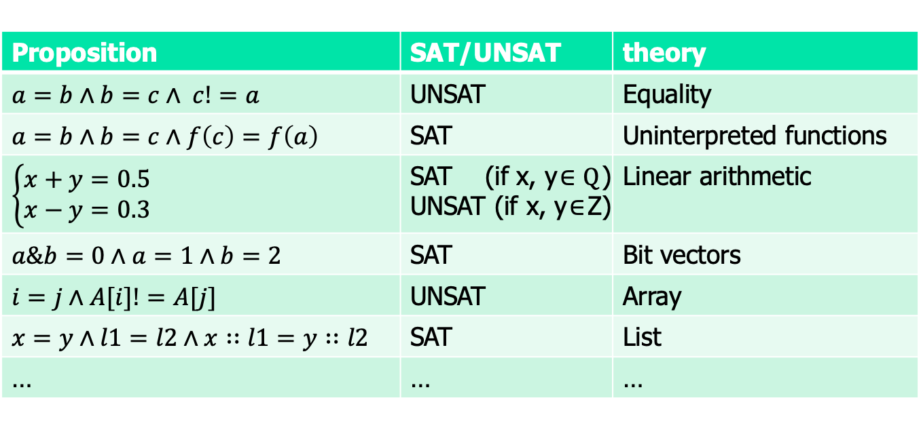
Motivation: theory
Are these satisfiable?
Proposition | SAT/UNSAT | theory
 | UNSAT | Equality
 | SAT | Uninterpreted functions
 |  | Linear arithmetic
 | SAT | Bit vectors
 | UNSAT | Array
 | SAT | List
… | … | …

Slide 3

Satisfiability modulo theory (SMT)
SAT
Theory
Solvers
SMT
Equality + UF
Arithmetic
Bit-vectors
…

Slide 4

Motivation
// A notorious bug in early JDK (fixed in 2006).
// The standard binary search (java.util.Arrays):
int binarySearch(int[] arr, int low, int high,
int target){
int mid = (low+high)/2;
if(arr[mid] == target)
return mid;
if(arr[mid] > target)
return binarySearch(arr, low, mid-1, target);
return binarySearch(arr, mid+1, high, target);
}
int = [$2^{−32}, 2^{31}−1$]

Slide 5
Bit vector
”Integers” and “reals” in CS are different from those in math
E.g., x – y >0 <--> x>y is true in math, but not in CS
E.g., 200+100 != 300 may be true
The theory of bit vectors
To model and reason about the representations and properties of numbers in CS

Slide 6
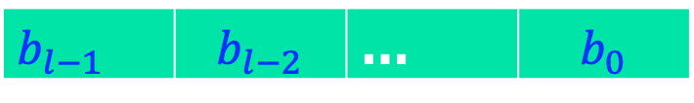
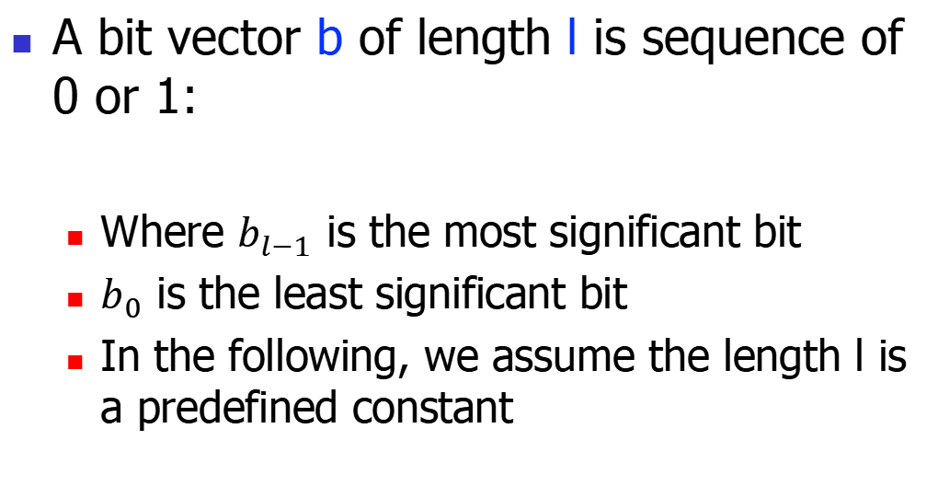
Bit vector, cont’
A bit vector b of length l is sequence of 0 or 1:
Where $b_{l−1}$ is the most significant bit
$b_{0}$ is the least significant bit
In the following, we assume the length l is a predefined constant
 |  | …

Slide 7


Bit vectors: the syntax
o ::= + | - | * | / | << | >> | & | | | xor
E ::= x | c | E o E | ~E
R ::= E=E | E<=E | E<E
P ::= R
$\text{|} \text{P}∧\text{P}$
o: a set of operators
Examples:
$$x==1∧y==3∧x\&y=0$$
UNSAT!
Examples in Z3:
x, y = BitVecs(‘x y’, 32)
solve(x==1, y==3, x&y ==0)

Slide 8
Semantics: bitwise operations
The bitwise operations are easy and straightforward
Just extensions of the bit operations
x&y = x[i] & y[i]
x|y = x[i] | y[i]
x xor y = x[i] xor y[i]
~x = ~x[i]
…

Slide 9

Semantics: arithmetic operations
Standard interpretations $\left\langle b\right\rangle$, for b:
${\left\langle b\right\rangle }_{U}=\sum_{i=0}^{l−1}{b_{i}∗2^{i}}$
${\left\langle b\right\rangle }_{S}={−b}_{l−1}∗2^{l−1}+\sum_{i=0}^{l−2}{b_{i}∗2^{i}}$
Example:
<11001000>U = 200
<11001000>S = -56

Slide 10
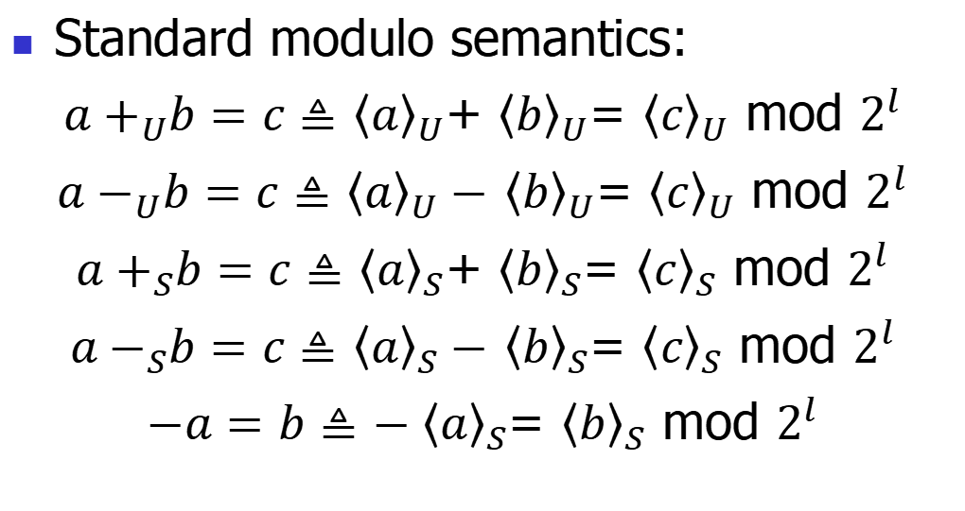
Semantics: arithmetic operations
Standard modulo semantics:
${a+}_{U}b=c≜$ ${\left\langle a\right\rangle }_{U}$+ ${\left\langle b\right\rangle }_{U}$= ${\left\langle c\right\rangle }_{U}$ mod $2^{l}$
${a−}_{U}b=c≜$ ${\left\langle a\right\rangle }_{U}−$ ${\left\langle b\right\rangle }_{U}$= ${\left\langle c\right\rangle }_{U}$ mod $2^{l}$
${a+}_{S}b=c≜$ ${\left\langle a\right\rangle }_{S}$+ ${\left\langle b\right\rangle }_{S}$= ${\left\langle c\right\rangle }_{S}$ mod $2^{l}$
${a−}_{S}b=c≜$ ${\left\langle a\right\rangle }_{S}−$ ${\left\langle b\right\rangle }_{S}$= ${\left\langle c\right\rangle }_{S}$ mod $2^{l}$
$−a=b≜$ ${−\left\langle a\right\rangle }_{S}$= ${\left\langle b\right\rangle }_{S}$ mod $2^{l}$

Slide 11
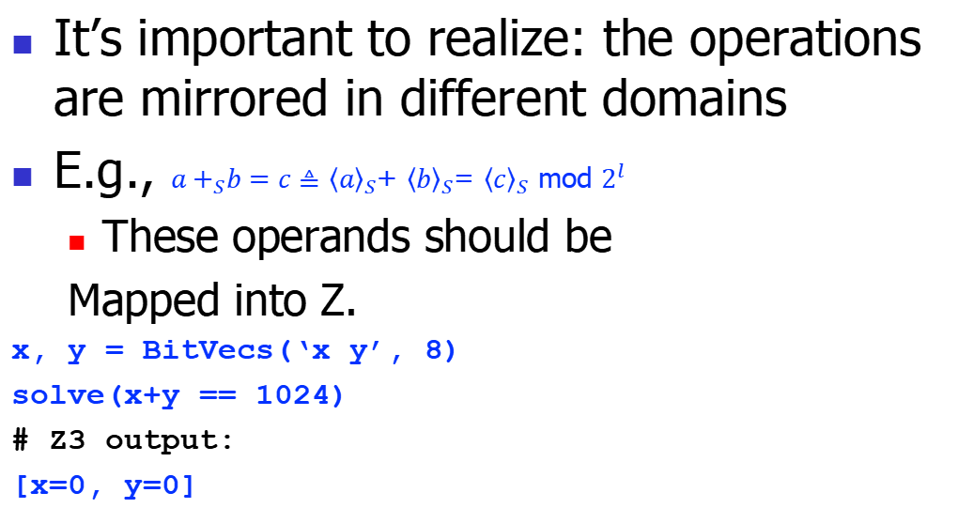
Semantics: arithmetic operations
It’s important to realize: the operations are mirrored in different domains
E.g., ${a+}_{S}b=c≜$ ${\left\langle a\right\rangle }_{S}$+ ${\left\langle b\right\rangle }_{S}$= ${\left\langle c\right\rangle }_{S}$ mod $2^{l}$
These operands should be
Mapped into Z.
x, y = BitVecs(‘x y’, 8)
solve(x+y == 1024)
# Z3 output:
[x=0, y=0]
BV
Z
$${\left\langle c\right\rangle }_{S}$$

Slide 12
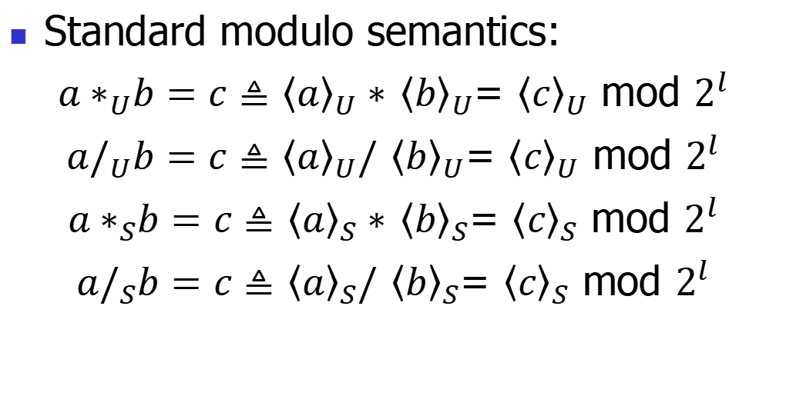
Semantics: arithmetic operations
Standard modulo semantics:
${a∗}_{U}b=c≜$ ${\left\langle a\right\rangle }_{U}∗$ ${\left\langle b\right\rangle }_{U}$= ${\left\langle c\right\rangle }_{U}$ mod $2^{l}$
${a/}_{U}b=c≜$ ${\left\langle a\right\rangle }_{U}/$ ${\left\langle b\right\rangle }_{U}$= ${\left\langle c\right\rangle }_{U}$ mod $2^{l}$
${a∗}_{S}b=c≜$ ${\left\langle a\right\rangle }_{S}∗$ ${\left\langle b\right\rangle }_{S}$= ${\left\langle c\right\rangle }_{S}$ mod $2^{l}$
${a/}_{S}b=c≜$ ${\left\langle a\right\rangle }_{S}/$ ${\left\langle b\right\rangle }_{S}$= ${\left\langle c\right\rangle }_{S}$ mod $2^{l}$

Slide 13
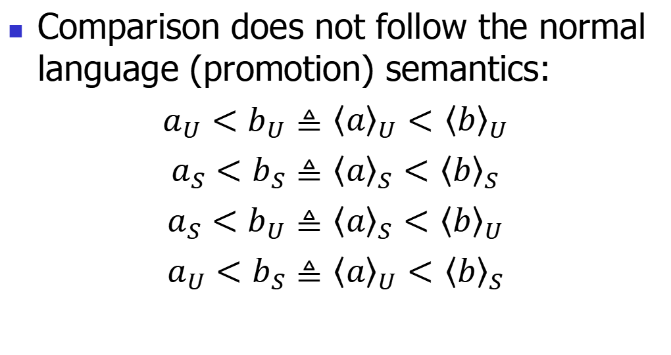
Semantics: arithmetic operations
Comparison does not follow the normal language (promotion) semantics:
$a_{U}<b_{U}≜$ ${\left\langle a\right\rangle }_{U}<$ ${\left\langle b\right\rangle }_{U}$
$a_{S}<b_{S}≜$ ${\left\langle a\right\rangle }_{S}<$ ${\left\langle b\right\rangle }_{S}$
$a_{S}<b_{U}≜$ ${\left\langle a\right\rangle }_{S}<$ ${\left\langle b\right\rangle }_{U}$
$a_{U}<b_{S}≜$ ${\left\langle a\right\rangle }_{U}<$ ${\left\langle b\right\rangle }_{S}$

Slide 14
Decision procedures for bit vectors

Slide 15
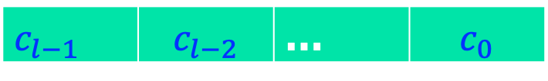
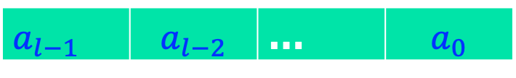
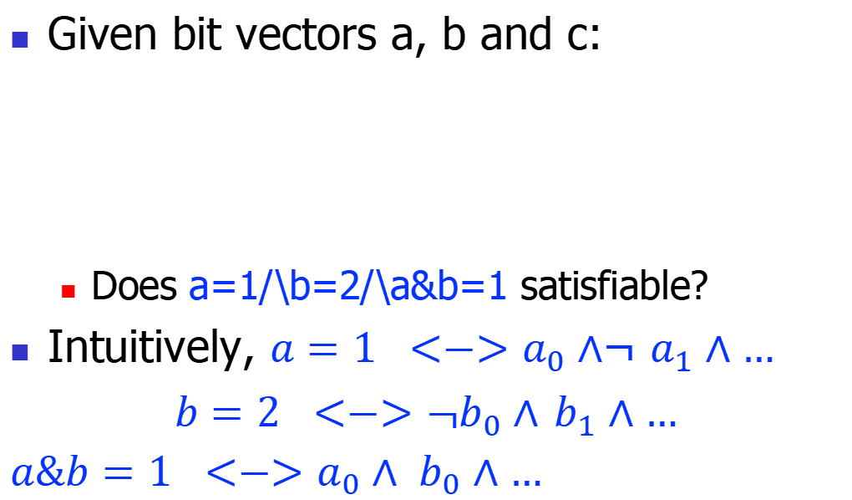
Motivation
Given bit vectors a, b and c:
Does a=1/\b=2/\a&b=1 satisfiable?
Intuitively, ${a=1 <−>a}_{0}∧$¬ $a_{1}∧…$
${b=2 <−>\text{¬}b}_{0}∧$ $b_{1}∧…$
${a\&b=1 <−>a}_{0}∧ b_{0}∧…$
 |  | …
T
T
F
 |  | …
 |  | …
T

Slide 16
Motivation
Bit vectors are represented by the corresponding propositions
Bit operations are compiled to the semantically equivalent operations on propositions
Also called constraints
These constraints are handled by a SAT
This is the bit-blasting algorithm

Slide 17
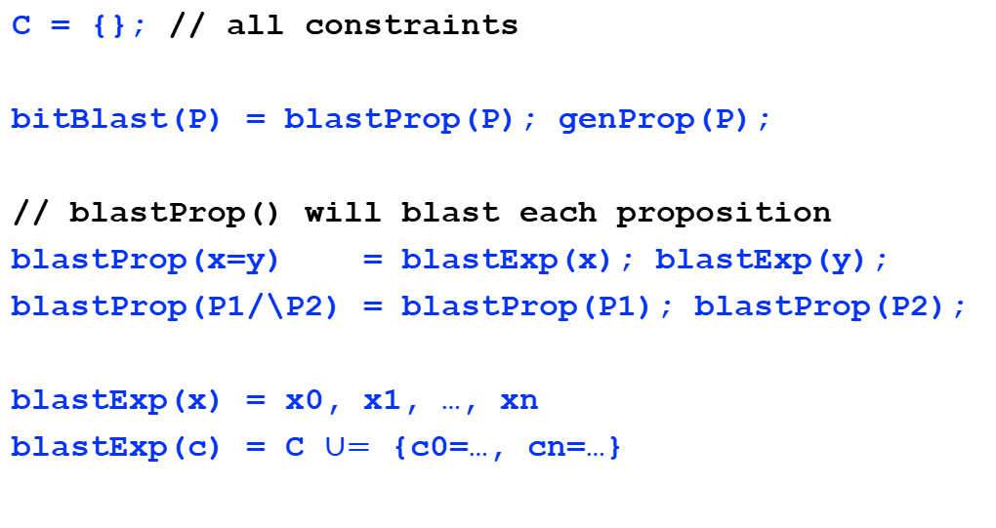
Bit-blasting algorithm
C = {}; // all constraints
bitBlast(P) = blastProp(P); genProp(P);
// blastProp() will blast each proposition
blastProp(x=y) = blastExp(x); blastExp(y);
blastProp(P1/\P2) = blastProp(P1); blastProp(P2);
blastExp(x) = x0, x1, …, xn
blastExp(c) = C $∪=$ {c0=…, cn=…}

Slide 18
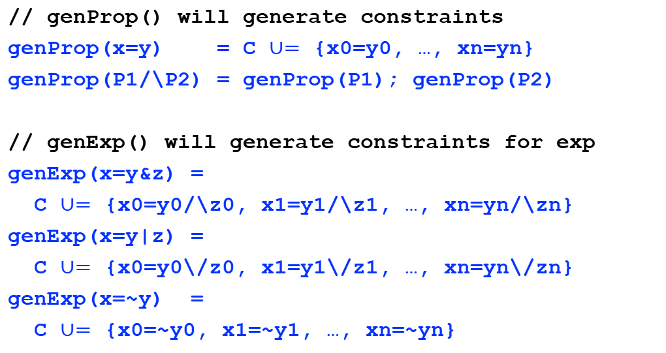
Bit-blasting algorithm, cont’
// genProp() will generate constraints
genProp(x=y) = C $∪=$ {x0=y0, …, xn=yn}
genProp(P1/\P2) = genProp(P1); genProp(P2)
// genExp() will generate constraints for exp
genExp(x=y&z) =
C $∪=$ {x0=y0/\z0, x1=y1/\z1, …, xn=yn/\zn}
genExp(x=y|z) =
C $∪=$ {x0=y0\/z0, x1=y1\/z1, …, xn=yn\/zn}
genExp(x=~y) =
C $∪=$ {x0=~y0, x1=~y1, …, xn=~yn}

Slide 19
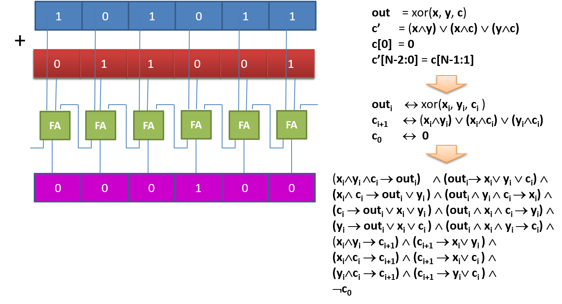
Bit-blasting algorithm, cont’
// genExp() will generates constraints for exp
genExp(x=y+z) =
c0=F/\
r0=xor(x0,y0,c0)/\c1=(x0/\y0)\/(xor(x0,y0)/\c0)
r1=xor(x1,y1,c1)/\c2=(x1/\y1)\/(xor(x1,y1)/\c1)
…

Slide 20
Bit-blasting algorithm, cont’
// For other arithmetic or comparison operations,
// we can transform them to the existing ones:
genExp(x=y-z) = genExp(x=y+(-z))
genExp(x=y*z) = genExp(x=y+…+y)
genExp(x=y/z) = z!=0/\d*z+r=x/\r<z

Slide 21
Example
// The 1st pass, bit blasting all constants
// we use C, D, E for constants.
a = 1 // C0=T, C1=F, ... Cn=F
b = 2 // D0=F, D1=T, …, Dn=F
c = a&b //
c = 1 // E0=T, E1=F, …, En=F
// The 2nd pass, generate constraints
a = 1 // a0=C0, a1=C1, …, an=Cn
b = 2 // b0=D0, b1=D1, …, bn=Dn
c = a&b // c0=a0/\b0, c1=a1/\b1, …, cn=an/\bn
c = 1 // c0=E0, c1=E1, …, cn=En

Slide 22
Incremental Bit Blasting

Slide 23

Motivation: the complexity
Consider the constraint complexity:
y&z=y0/\z0, y1/\z1, …, yn/\zn
2*n props, n conjunctions
y*z =
$$\underbrace{\text{y}\text{+}\text{y}\text{+…+}\text{y}}$$
z

Slide 24
Motivation
And consider:
a*b=c/\b*a!=c/\y=x&z/\y!=x&z
Direct encoding of the formula generate more than 10000 vars, problematic for current SAT solvers
What’s the problem here? How to fix?

Slide 25
Incremental Algorithm
a*b=c/\b*a!=c/\y=x&z/\y!=x&z
Analyze the “easier” part
This is called an incremental algorithm. Essentially a lazy strategy.
solve
SAT
Analyze the “hard” part
UNSAT
finished

Slide 26
Bit-vectors applications

Slide 27
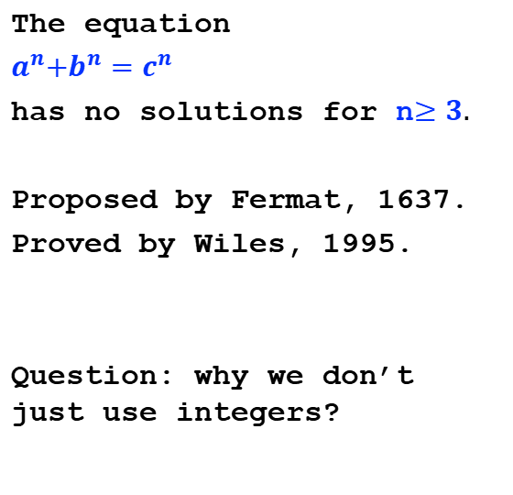
#1: Fermat‘s last theorem
solver = Solver()
a, b, c = BitVecs(‘a b c’, 64)
magic = 0xffffffffffff0000
solver.add(a&magic == 0)
solver.add(b&magic == 0)
solver.add(c&magic == 0)
solver.add(a*a*a + b*b*b
== c*c*c)
solver.check()
The equation
$a^{n}{+b}^{n}=c^{n}$
has no solutions for n$≥3.$
Proposed by Fermat, 1637.
Proved by Wiles, 1995.
Question: why we don’t just use integers?

Slide 28
Summary
Bit vectors offer a natural abstraction for numbers in computers
not only integers, but also reals
Thus very convenient to reason about computer programs
to discuss more in future lectures

